Slide 1
A/B Testing: Impact of Discounts on Customer Spending Statistical Analysis of Promotional Offers
Question 3 hypothesis testing analysis using Python and scipy.stats
$48.96
Group A Mean
$55.27
Group B Mean
-4.3164
t-statistic
0.00002560
p-value
Presented by Kporxah Kennedy John
CS 4/5630 - Python for Computational and Data Sciences

Slide 2
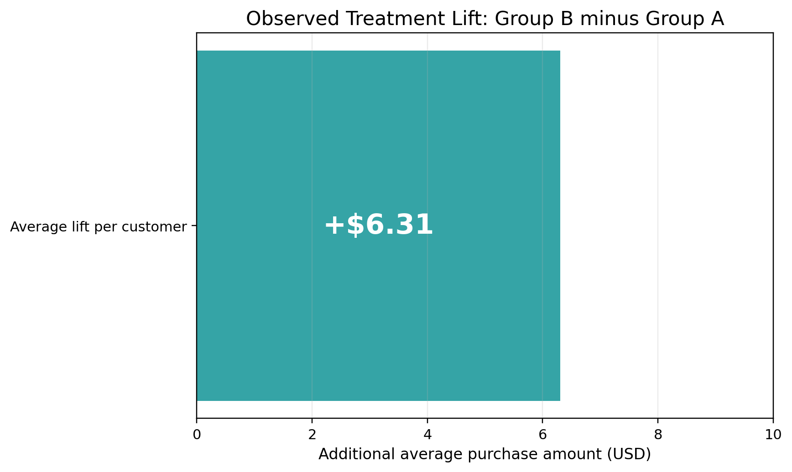
Project Objective
Testing whether a 10% discount changes average customer purchase amount
Core research question
Does a 10% promotional discount create a statistically significant change in customer purchase amount?
Use Python to move from descriptive patterns to inferential evidence.
Support the final answer with charts, t-statistic, p-value, and business interpretation.
Observed average lift: Group B minus Group A
Executive answer
Group B spent about $6.31 more on average, and the t-test result rejects H0 at alpha = 0.05.
02

Slide 3
Dataset and Experimental Design
Synthetic A/B testing structure from the provided notebook
Group A - Control
Group B - Treatment
Variables
No discount
n = 100 customers
Mean = $48.96
Std. dev. = $9.08
10% discount
n = 100 customers
Mean = $55.27
Std. dev. = $11.44
customer_id
group label: A or B
purchase_amount in USD
Random seed = 42 for reproducibility
03

Slide 4
Python Implementation Workflow
Notebook code reproduced exactly for the premium charts and outputs
Analysis sequence
from scipy import stats t_stat, p_val = stats.ttest_ind( group_a, group_b, equal_var=False ) print(f"Test Statistic: {t_stat:.4f}") print(f"P-value: {p_val:.8f}")
1. Generate synthetic purchase data with NumPy
2. Build pandas DataFrame with customer_id, group, and purchase_amount
3. Compute group-level descriptive statistics
4. Visualize histogram, KDE, boxplot, and mean comparison
5. Run scipy.stats.ttest_ind for Question 3
6. Interpret statistical and practical significance
04

Slide 5
Summary Statistics
The discount group shows a higher mean, median, and maximum purchase amount
Metric | Group A | Group B
Sample size | 100 | 100
Mean | $48.96 | $55.27
Median | $48.73 | $56.01
Std. dev. | $9.08 | $11.44
Minimum | $23.80 | $31.97
Maximum | $68.52 | $87.64
Initial readout
Group B mean is $6.31 higher than Group A.
The treatment group also has a larger standard deviation, suggesting more varied customer responses.
Descriptive evidence supports a discount effect, but a t-test is needed to confirm statistical significance.
05

Slide 6
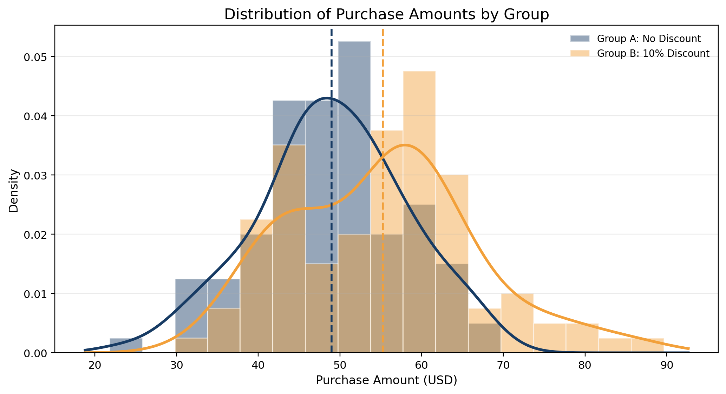
Histogram and KDE Overlay
Visual evidence of a rightward distribution shift for the discount group
What the graph shows
Group B appears more concentrated in higher spending ranges.
The orange mean line sits to the right of the blue mean line.
The visual pattern is consistent with higher average spending under the discount.
Histogram with KDE overlay from the reproduced notebook data
06

Slide 7
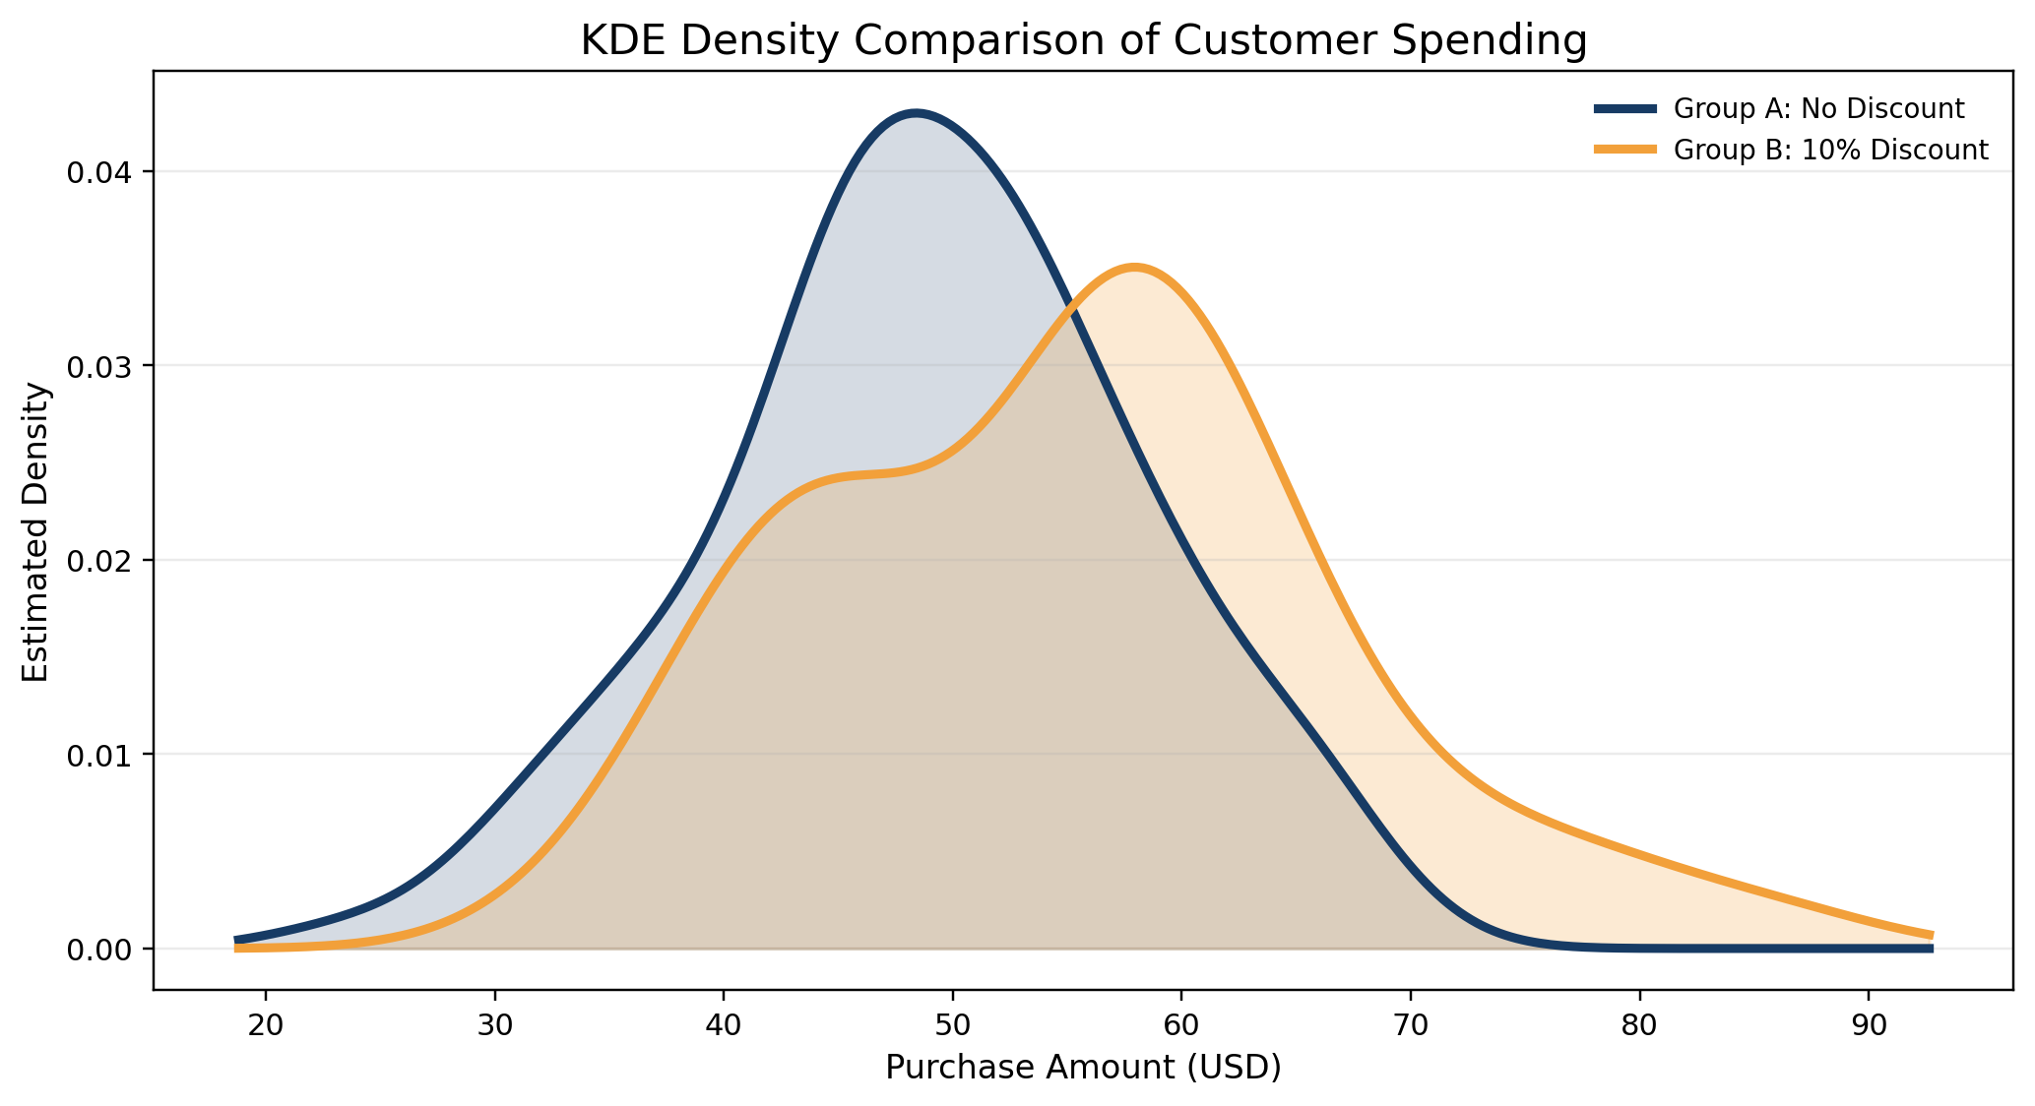
KDE Distribution Analysis
The treatment distribution shifts upward, not just one extreme point
Interpretation
The Group B curve peaks at a higher purchase amount.
Group B extends further into the high-spending range.
This suggests a broader behavioral shift, not only isolated outliers.
Smoothed density curves by group
07

Slide 8
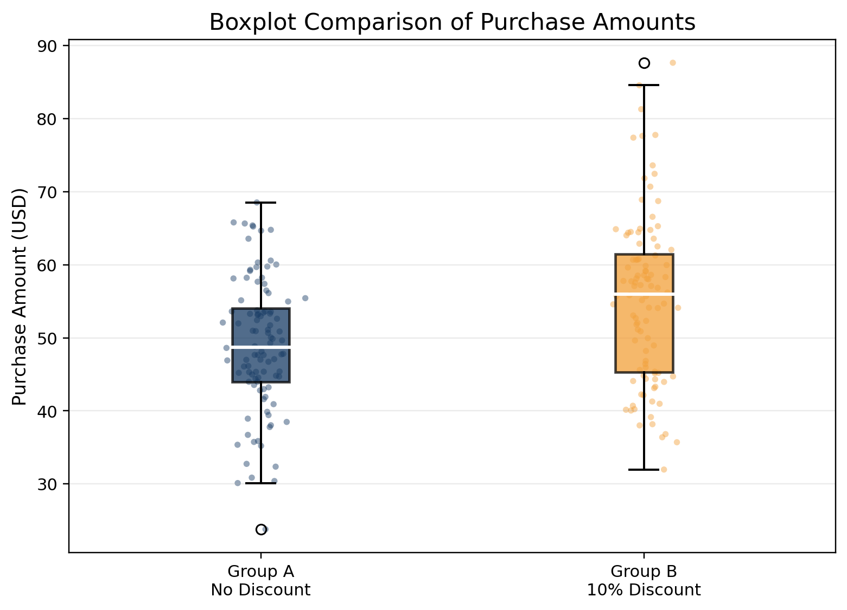
Boxplot Analysis
Median, spread, and outlier comparison
Key takeaways
Group B has a higher median purchase value.
Group B shows wider variability, meaning customer response to the discount differs across shoppers.
Outliers do not explain the entire treatment effect; the center of the distribution also moves upward.
Boxplot with individual jittered observations
08

Slide 9
Hypothesis Formulation
Question 3 requires hypothesis testing using scipy.stats
Null hypothesis, H0
Alternative hypothesis, H1
mu_A = mu_B
The average purchase amount is the same for both groups.
The discount has no effect on mean spending.
mu_A != mu_B
The average purchase amount differs between groups.
The discount changes customer spending behavior.
Because the research question asks whether spending changes, a two-sided independent samples t-test is appropriate.
09

Slide 10
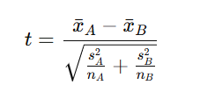
T-Test Implementation
The test compares the observed mean gap to expected sampling variation
Why this test is appropriate
The groups are independent customer samples.
The goal is to compare average purchase amounts.
The notebook uses scipy.stats.ttest_ind with equal_var=False, implementing Welch’s independent two-sample t-test.
The output directly answers Question 3 by reporting the t-statistic.
Formula
The negative t-value occurs because the average purchase amount of Group A is lower than that of Group B.
10

Slide 11
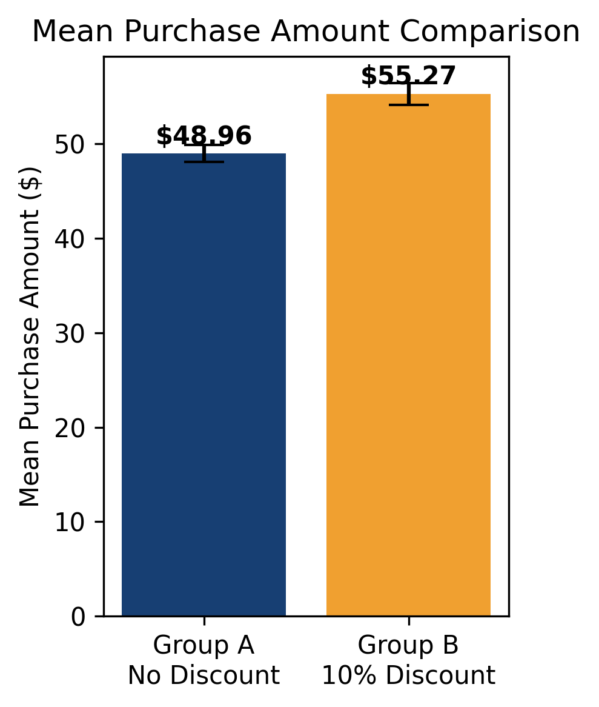
Statistical Results
Exact output from the provided notebook and reproduced data
$48.96
Group A Mean
$55.27
Group B Mean
-4.3164
t-statistic
0.00002560
p-value
Decision rule
alpha = 0.05
p-value = 0.0000
Because p < 0.05, reject H0.
The discount significantly changes average purchase amount.
Mean comparison with 95% confidence intervals
11

Slide 12
Statistical Interpretation
The observed difference is unlikely to be random sampling noise
Interpretation of t and p
Plain-language conclusion
t = -4.3164 indicates Group A mean is lower than Group B mean.
The p-value rounds to 0.00002560, far below 0.05.
The null hypothesis of equal means is rejected.
The statistical evidence supports a treatment effect from the discount.
Customers receiving the 10% discount spent about $6.31 more on average.
The increase is statistically reliable in the simulated A/B test.
The discount appears to influence customer buying behavior.
12

Slide 13
Practical Business Significance
A statistically significant lift must still be tested against profit margin
Business question
The promotion increases gross cart value.
However, the company gives away 10% of the transaction value.
Profitability depends on margin, item mix, customer retention, and repeat purchases.
Next step: run margin-based live A/B testing.
The Math
We have mathematical certainty that offering a 10% discount changes consumer behavior, pushing them to add more items or higher-value items to their carts.
Observed spending lift
13

Slide 14

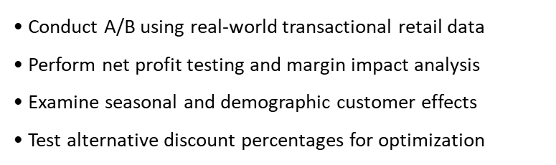
Strengths and Future work
Strong statistical evidence with clear next steps
Strengths
Clear Experimental Design Using A/B Testing
Reproducible Synthetic Dataset
Proper Use of Welch Independent Two-Sample T-Test
Fully Automated Python Workflow
Combination of Descriptive and Inferential Statistics
14

Slide 15
Limitations and Final Conclusion
Strong statistical evidence with clear next steps
Limitations
Final conclusion
Data are synthetic rather than live transactions.
Real retail data may be skewed or affected by seasonality.
The analysis does not include margin, cost of goods sold, or long-term retention.
Averages can be influenced by extreme purchases.
Group B mean: $55.27 vs Group A mean: $48.96.
Notebook t-test: t = -4.3164, p = 0.0000.
Reject H0: the 10% discount significantly changes spending.
Recommended next step: validate with real data and margin analysis.
15

Slide 16
References
Virtanen, P., Gommers, R., Oliphant, T. E., Haberland, M., Reddy, T., Cournapeau, D., ... & SciPy 1.0 Contributors. (2020). SciPy 1.0:
Fundamental algorithms for scientific computing in Python. Nature Methods, 17(3), 261–272.
SciPy Developers. (2025). scipy.stats.ttest_ind — SciPy Statistical Functions Documentation. Retrieved from SciPy Official Documentation. This function performs independent two-sample t-tests and Welch’s t-test for unequal variances.
Montgomery, D. C. (2019). Design and Analysis of Experiments (10th ed.). John Wiley & Sons.
McKinney, W. (2022). Python for Data Analysis: Data Wrangling with pandas, NumPy, and Jupyter (3rd ed.). O’Reilly Media.
Hunter, J. D. (2007). Matplotlib: A 2D graphics environment. Computing in Science & Engineering, 9(3), 90–95.
Week 15 Learning Activity, Python for Computational and Data Sciences.

